Slide 1
Adversity & Trauma
What do we need to think about?
Notes:
This presentation provides an account of what is important in childhood adversity and trauma, and relates this to the famous ACE studies.
It is part of the training materials used in Highland Council and written by James McTaggart, Early Years Educational Psychologist – it is free to use with attribution.

Slide 2
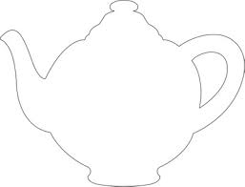
How the brain makes decisions
Imagine a stressful situation that requires quick decision making
For example, picking up a teapot that turns out to be painfully hot …
How do we manage this?
What do we need in our brains to cope?

Slide 3
Calibrated stress reactions
(Not too little and not too much)
Notes:
First off, we need a quick stress reaction – for fast survival decisions
But this needs to be calibrated – so we have “just enough” arousal to cope with a situation.
Hot teapot is painful, but not life and death – so we need some stress, but not a lot

Slide 4
Actions menu
Option #1
Option #2
Option #3
…
…
…
Calibrated stress reactions
(Not too little and not too much)
Notes:
Next, we need a menu of actions in our head
If the only thing we know to do is to drop things, that’s what we do whatever the stress reaction.
This is important because often we talk about the stress system as though it is the only thing that matters for ACEs – not necessarily, as we will see.
But we are competent adults, so we know lots of actions – dropping, throwing, putting down gently, saying “ow ow ow” to help soothe, etc

Slide 5
Effective inhibition and planning
Effortlessly controlled muscle actions
Actions menu
Option #1
Option #2
Option #3
…
…
…
Calibrated stress reactions
(Not too little and not too much)
Notes:
But no point having those actions as alternative unless we can stop the reflex response to drop
So we need to be able to “inhibit” the actions we don’t want – and we need to be able to control our muscle actions.
These systems have various names – in my discipline we’d call it “executive function” – what enables us to plan, stop and start, etc
Without strong executive function, we will tend to do the instinctive stress behaviours more often, or even act more randomly
We might really intend to put the teapot down carefully, but end up dropping it because our inhibitory ability is too weak
Trauma and adversity affects the development of these systems in subtle ways, including how we unconsciously assess the likely reward value of different actions

Slide 6
Effective inhibition and planning
Effortlessly controlled muscle actions
Sequence and narrative representations to assess consequences
Actions menu
Option #1
Option #2
Option #3
…
…
…
Calibrated stress reactions
(Not too little and not too much)
Notes:
Still not there, though – even more brain is involved!
We need representations of sequence and narrative – “this, then that”; “if this, then that” – to be able to reason about consequences
If it is just our own cheap teapot and we are outside, who cares, drop it! If it is Nana’s priceless Ming Dynasty teapot, maybe not
We do consequential thinking all the time, and it relies on these basic sequence & narrative structures (sometimes called schemas)

Slide 7
Effective inhibition and planning
Effortlessly controlled muscle actions
Sequence and narrative representations to assess consequences
Actions menu
Option #1
Option #2
Option #3
…
…
…
Language skills to support reasoning
Calibrated stress reactions
(Not too little and not too much)
Notes:
This reasoning goes all the better if we have the language to do it with.
All kinds of thought is supported & speeded up by language processing in the background
Think of the kinds of self-talking we all use for behaviour regulation (you can observe this the next time you decide not to send “that” email response)

Slide 8
Effective inhibition and planning
Effortlessly controlled muscle actions
Memories of coping/adjusting
Sequence and narrative representations to assess consequences
Actions menu
Option #1
Option #2
Option #3
…
…
…
Language skills to support reasoning
Calibrated stress reactions
(Not too little and not too much)
Social scripts for what’s appropriate
Notes:
And lastly, hooray!
We need some social scripts for what is appropriate – if we all went around dropping teapots, where would we be? This helps fine tune decision making – but is also a quick route to a solution – IF we also have memories of coping and adjusting
The more experience we can draw on of similar (or similar-feeling) situations, the better -it gives us content for the decision making

Slide 9
Instead of a teapot?
Steal a car
Use some drugs
Take out a payday loan
Have another drink
Lash out
Take medical advice
Go in to school
Follow rules
Eat healthily
Turn up for work
Study
Plan for future
Respond to children
Put down the phone
Avoid self-harm
ETC
Notes:
Who cares about teapots? It is just a silly example.
But the same brain processes underlie all behavioural outcomes including some of these that we really do care about

Slide 10
The adaptive brain …
Effective inhibition and planning
Effortlessly controlled muscle actions
Memories of coping/adjusting
Sequence and narrative representations to assess consequences
Actions menu
Option #1
Option #2
Option #3
…
…
…
Language skills to support reasoning
Calibrated stress reactions
(Not too little and not too much)
Social scripts for what’s appropriate
Notes:
This is the adaptive brain that enables us to navigate all these difficulties.
It is quite complex (and this is only the easily described parts) – and that is one of my main messages – we have to think about how children develop all of these if we want to reduce the impact of adversity

Slide 11
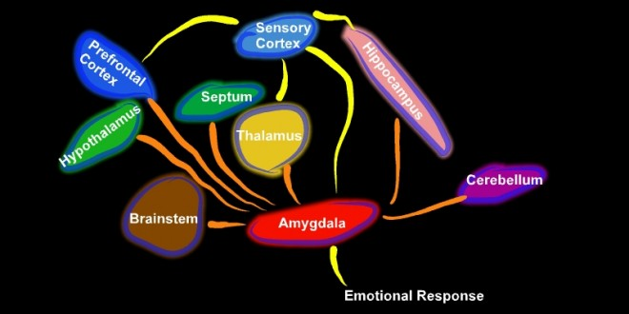
Brain picture?
Notes:
For those who like incomprehensible brain pictures – and so you can Google and check – these are some of the brain areas that underlie what I’ve been talking about

Slide 12
How did we get there?
Have we?
Sufficient stress and it breaks down
Compare a 4 year old …
Notes:
So, key question for us – how do we get from embryo to this complex, adaptive, flexible adult brain?
In a way we have not – enough stress and it all falls apart (think of “that” email you sent …)
Let’s compare, though, a typical 4 year-old

Slide 13
An experiment …
The Stanford marshmallow study
  Replicated many times
  Predicts
    Adolescent adjustment
    Academic performance and IQ
    Body mass index and health
    Credit rating
  DO NOT try it at home!
Notes:
Now a classic experimental procedure.
Many variants, but basically – you give a child a marshmallow (or other treat) on a plate. Say, “this is yours, but I’m going away for X minutes – if when I come back the marshmallow is still there, you can have two!”
Let’s look at what happens:

Slide 14


Slide 15


Slide 16
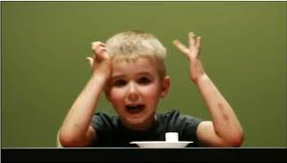

Slide 17
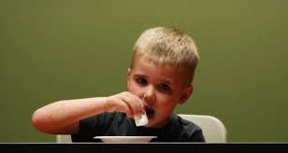
Notes:
The child has the actions, it is not a stressful (very) situation – but the plan breaks down because there is not enough executive function to stop the eating. Also possibly not sufficiently strong narrative processing yet to deal with an abstract imagined future gain.
Etc.

Slide 18
How do we get here?
Effective inhibition and planning
Effortlessly controlled muscle actions
Memories of coping/adjusting
Sequence and narrative representations to assess consequences
Actions menu
Option #1
Option #2
Option #3
…
…
…
Language skills to support reasoning
Calibrated stress reactions
(Not too little and not too much)
Social scripts for what’s appropriate
Notes:
So, discussion activity – how do we get from 4 year-old to us? What kinds of experiences build this brain?

Slide 19
What we need to build a brain
Developmentally appropriate experiences
Reflective & sensitive care
Moderate stress & recovery
Good physical health
Notes:
No matter how big a list we make, it can probably be boiled down to these four areas.
Developmentally appropriate experiences range from being chatted to as a baby to having suitable ways to feel risk as an adolescent. It includes, of course, appropriately differentiated learning in school – and all the things that we know help kids flourish such as lots of chances to play and get outside. Really important to remember we need to develop not just the emotions here but also the movement and language skills – think inhibition and muscle control.
Reflective and sensitive care – I’ll talk more about in a moment – this includes what people mean when they talk about attachment and positive relationships
Moderate stress and recovery – lots of experiences of things we can just about manage – or can manage with help from an adult. This is what calibrates the stress system. For a baby this might be the short pause before a caregiver responds to a cry (they had to put the teapot down first) – for a tween it might be the mild strain in a relationship caused by being a bit cheeky, and so on. It is also all the rupture and repair patterns that occur in relationships with parents and other adults
What is moderate stress depends on the “reflective and sensitive care” bit – ideally adults can “buffer” stress for kids
Finally, the essential substrate of the things that build good physical health – nutrition, shelter, sleep, etc. Lots of evidence showing the impact on development of these alone

Slide 20
Adverse Childhood Experiences?
Developmentally appropriate experiences
Reflective & sensitive care
Moderate stress & recovery
Good physical health
Anything that disrupts these!
Notes:
So we have a working definition of what is adverse childhood experience.
It is rough and ready, but inclusive of all the things we need to include.
It is also practical because it shows us where/how to intervene

Slide 21
For example
Jack is 8 years old. He lives with his father, Alex, in a small rural town. Last February, Alex lost his job, and has not coped well. Since then, they have struggled with bills and expenses – men come to the door often and shout and threaten Alex. Jack has outgrown his school clothes, and he has started to lose golden time due to getting into fights
Notes:
A very familiar kind of scenario. I use this in our multi-agency training to show how focussed interventions need to be, and how we all need to work together to provide buffers against adversity.
Can you map out where the 4 processes are under threat for Jack?
And can you see how we might intervene, or support Alex to intervene, such that the processes are ensured?

Slide 22
How does this relate to ACE studies?
Large sample, longitudinal/retrospective
  Association of early adversity with later health
  Evidence for stress & allostatic load pathways
  Useful at population level
Establishes the “burden”, but how to reduce?
  To intervene we need to “zoom in”
  Understand the different pathways
  How those play out for individual/each family
  Emphasis on environment
Notes:
How does all this relate to the ACE studies that tend to get most attention?
The research effectively shows the “burden” of some kinds of adversity at a population level, and there are some studies looking at the linking pathways via inflammation and allostatic load.
If we want to buffer ACEs for individuals though, we need to zoom in – and think more widely and deeply about the processes of adversity and how these act differently for each individual and family context.
There is not any sense in which one “ACE” is like another, or that in a given family context any given ACE acts the same way as it would in another family context.
Unfortunately, some of the national conversation can get polarised such that pointing out the complexity of the research is taken as resistance to it – we need to get past this.

Slide 23
Adverse childhood experience ….
How depriving?
How dysregulating?
McLaughlin, K.A., Sheridan, M.A. & Nelson, C.A. (2017). Neglect as a Violation of Species-Expectant Experience: Neurodevelopmental Consequences, Biological Psychiatry, 82, pp.462–471
Notes:
Here’s one way to look at how ACEs differ from each other, and differ by context.
We can ask how stressful an experience is – and also how “depriving” it is. Depriving is not quite the right word, but the sense is clear.
For example, Calum at 6 months is being exposed to lots of repeated domestic violence (dysregulating). But his elder sister spends lots of time playing and talking with him (less depriving). Struan (2 year old) is in a loving home but is rarely talked to or let out of the buggy (not dysregulating, but depriving)
If we just concentrate on the stress pathway, we miss the effects of adversity for Struan – and the possible buffer for Calum.

Slide 24
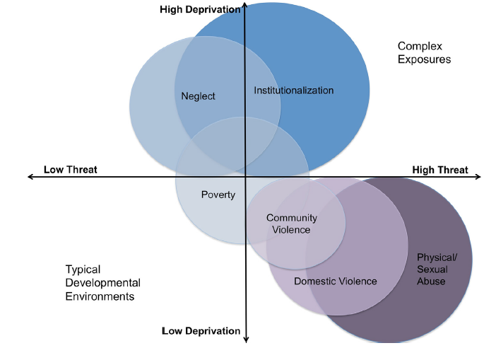
Notes:
Here’s how the same researchers develop their model for some of the “canonical” adversities.
You probably don’t agree (I don’t – think of Calum just now) with where they have plotted everything – that’s the point – for any family, this may be totally different and this is what we need to think about.

Slide 25
Beyond quantities
Effects of ACEs depend on
  Developmental timing
  The individual context and experience
  The particular ACE
  The balance of stress and deprivation involved
  Gender (?)
  Genetics
  Things we don’t know
Notes:
In fact, there is plenty of research showing that the effects of adversity depend on all these things.
So we don’t need to get bogged down in worrying about whether X or Y is an ACE, or how many someone has, etc.
At the individual, family or even community level, this is irrelevant – what matters is the individual experience of the disruption or promotion of the four key developmental processes.

Slide 26
Reducing lifetime ACE impact?
Developmentally appropriate experiences
Reflective & sensitive care
Moderate stress & recovery
Good physical health
Anything that promotes these!
Notes:
This is where ACE talk should really be hopeful – if we know the processes that adversity disrupts, then we know what processes to support through prevention and intervention.
Before I show some bits of work around this, I want to flesh out the key ingredient of “reflective and sensitive care” as this can get a bit vague and bogged down in overly simplified ideas about secure attachment etc.

